Slide 1
Setting up your machine
Download a copy of R on your local computer from the Comprehensive R Archive Network (CRAN). You can choose between binaries for Linux, Mac and Windows.
Install one of R’s integrated development environment (IDE), RStudio, which makes R coding much easier and faster as it allows you to type multiple lines of code, handle plots, install and maintain packages and navigate your programming environment much more productively.
https://cran.r-project.org/doc/manuals/R-intro.pdf
Download contents located in the Github
https://github.com/dixond2014/Bevera-R
Notes:
If you currently use another statistical package, why learn R?
It's free! If you are a teacher or a student, the benefits are obvious.
It runs on a variety of platforms including Windows, Unix and MacOS.
It provides an unparalleled platform for programming new statistical methods in an easy and straightforward manner.
It contains advanced statistical routines not yet available in other packages.
It has state-of-the-art graphics capabilities.

Slide 2


Statistical Analysis in R
Participant’s Guide
September 30th, 2020 Instructors: Yvonne Phillips
Vincent Lott

Slide 3

About BeVera
Founded in 2013
HQ in Metro Atlanta
Veteran-Owned Small Business
Data Science Training and Consulting
Technical Staffing
Dedicated to making Data Science understandable and usable at every level of the organization
Helping our customers become self-sufficient

Slide 4

BK Ashford, Director of Data Science
Over 22 years of Data Science solution delivery experience
Analytical Consultant for SAS Institute for over 11 years
Successful Data Science solution delivery across multiple industries
Insurance Carriers
Major Airlines
Credit Bureaus
Retail
Education:
M.Sc. Applied Mathematics, Lehigh University
B.S. Mathematics, Morehouse College

Slide 5
Yvonne Phillips, INSTRUCTOR
18 years of Predictive Analytics work
Currently Adjunct Professor, Morehouse College – Computer Science/Data Science
Experienced analytic professional with demonstrated history in:
Insurance: Underwriting Auto & Property, Motor Vehicle Reporting Analytics
Government: Federal and State/Local government customer solutions needs
Financial/Credit Cards
Retail
Education:
M.Sc., Decision Science, Georgia State University, Robinson College of Business
B.S., Mathematics, Spelman College

Slide 6
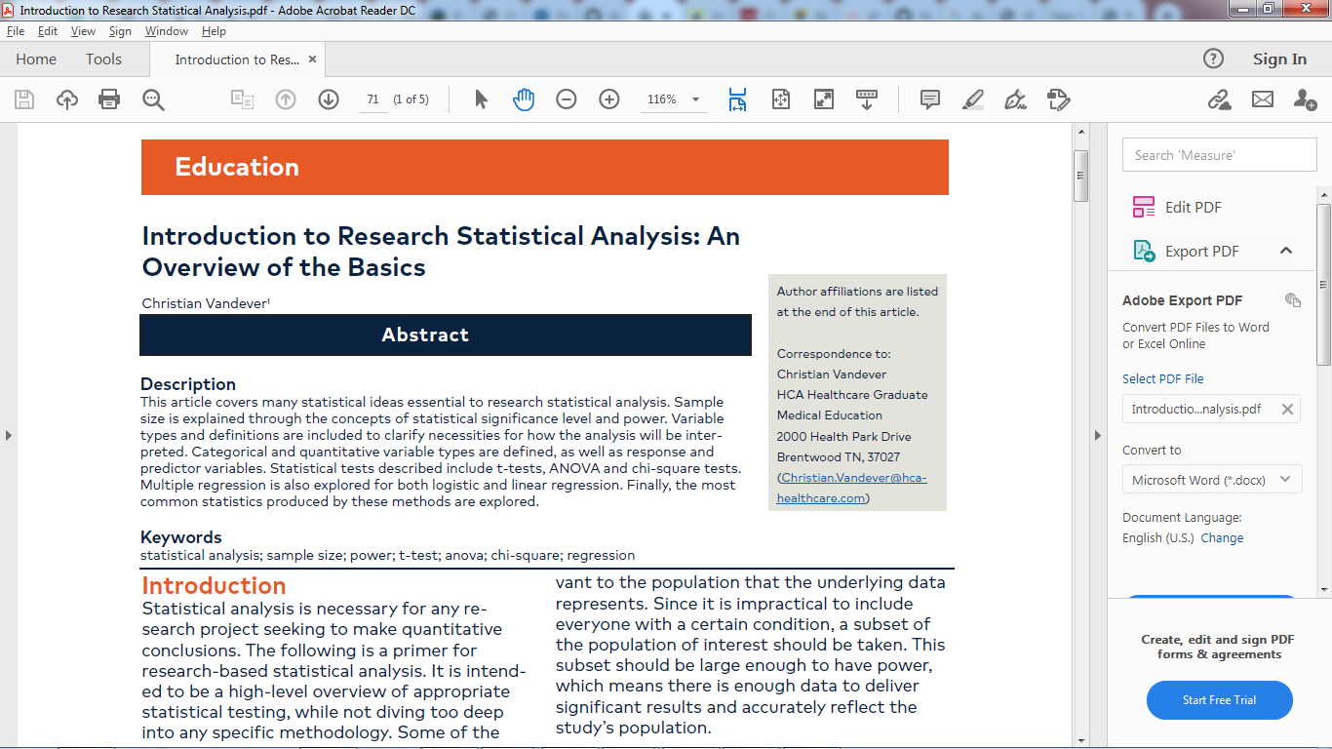
Read article:

Slide 7

R Programming Language
https://cran.r-project.org/doc/manuals/R-intro.pdf
Notes:
The R language provides a rich environment for working with data, especially data to be used for statistical modeling or graphics. Coupled with the large variety of easily available packages, it allows access to both well-established and experimental statistical techniques.
We use R to explore, analyze, and understand public health data.
We analyze data straight out of tables provided in reports or articles
Full-function calculator
Extensible statistical package
High-quality graphics tool
Multi-use programming language
ell as analyze usual data sets.

Slide 8
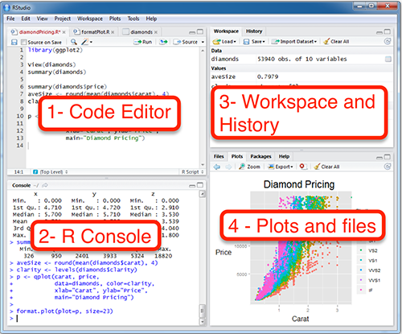
RStudio is a four pane work-space for 1) creating file containing R script, 2) typing R commands, 3) viewing command histories, 4) viewing plots and more.
3.Top-right panel: ◦Workspace tab: shows the list of R objects you created during your R session ◦History tab: shows the history of all previous commands
1.Top-left panel:
◦Code editor allowing you to create and open a file containing R script.
◦The R script is where you keep a record of your work. R script can be created as follow: File –> New –> R Script
4.Bottom-right panel:
◦Files tab: show files in your working directory ◦Plots tab: show the history of plots you created. From this tab, you can export a plot to a PDF or an image files ◦Packages tab: show external R packages available on your system. If checked, the package is loaded in R.
2.Bottom-left panel:
◦R console for typing R commands

Slide 9

Importing your data
R allows for the import of different data formats using specific packages that can make your job easier:
readr: importing flat files into R
readxl: getting excel files into R
haven: import SAS, STATA and SPSS data files into R.
RMySQL and RpostgreSQL: Databases, access and manipulate via DBI
rvest: webscraping
Example: mydata=read.csv(file=“C:/…..csv”, header=TRUE)
https://www.datacamp.com/community/tutorials/r-data-import-tutorial
Notes:
Webscraping?
Comprehensive and easy R Data Import tutorial covering everything from importing simple text files to the more advanced SPSS and SAS files.
`Almost every single type of file that you want to get into R seems to require its own function
Save your data in an external .txt tab or .csv files
Import your data into R as follow:

Slide 10


Manipulating your data
tidyr package: tidying the data
stringr package: string manipulation
dplyr package: for data frame like objects
set of verbs: mutate(), select(), filter(), summarise(), arrange()
data.table package: heavy data wrangling tasks
zoo, xts and quantmod: Performing time series analysis

Slide 11
Using packages
1
2
install.packages("readr")
library("readr")
Downloads files to computer
Loads package
1 x per computer
1 x per R Session
CC BY-SA RStudio

Slide 12


Notes:
Statistical Analysis (in R)

Slide 13
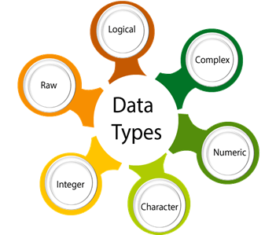
Notes:
R has five data types which are:
Numeric - The numeric data type is for numeric values. It is the default data type for numbers in R.
Integers
Complex
Logical
Characters
can also use the capital ‘L’ notation to denote that a particular value is of the integer data type
4.5 is a decimal value called numerics.
4 is a natural value called integers. Integers are also numerics.
TRUE or FALSE is a Boolean value called logical.
The value inside " " or ' ' are text (string). They are called characters.

Slide 14
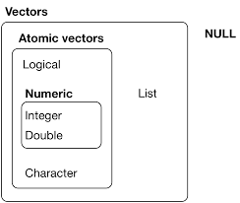
Data Types in R
> typeof(letters)
> typeof(1:10)
> x <- list("a", "b", 1:10)
> length(x)
Notes:
There are two types of vectors:
Atomic vectors, of which there are six types: logical, integer, double, character, complex, and raw. Integer and double vectors are collectively known as numeric vectors.
Lists, which are sometimes called recursive vectors because lists can contain other lists.
The chief difference between atomic vectors and lists is that atomic vectors are homogeneous, while lists can be heterogeneous. There’s one other related object: NULL. NULL is often used to represent the absence of a vector (as opposed to NA which is used to represent the absence of a value in a vector). NULL typically behaves like a vector of length 0.
Include raw
R has five data types which are:
Numeric - The numeric data type is for numeric values. It is the default data type for numbers in R.
Integers
Complex
Logical
Characters
check the type of a variable with the class function
Logical vectors are the simplest type of atomic vector because they can take only three possible values: FALSE, TRUE, and NA. Logical vectors are usually constructed with comparison operators, as described in comparisons.
Numeric
Integer and double vectors are known collectively as numeric vectors. In R, numbers are doubles by default. To make an integer, place an L after the number:
typeof(1) #> [1] "double" typeof(1L) #> [1] "integer“
The distinction between integers and doubles is not usually important, but there are two important differences that you should be aware of:
Doubles are approximations. Doubles represent floating point numbers that can not always be precisely represented with a fixed amount of memory.
Integers have one special value: NA, while doubles have four: NA, NaN, Inf and -Inf. All three special values NaN, Inf and -Inf can arise during division:
Character
Character vectors are the most complex type of atomic vector, because each element of a character vector is a string, and a string can contain an arbitrary amount of data
Categorical Qualitative data are often termed categorical data. Data that can be added into categories according to their characteristics.
Nominal Variable (Unordered list) A variable that has two or more categories, without any implied ordering. (gender/marital status)
Ordinal Variable (Ordered list) A variable that has two or more categories, with clear ordering.
Interval An interval variable is similar to an ordinal variable, except that the intervals between the values of the interval variable are equally spaced. In other words, it has order and equal intervals.
Ratio It is interval data with a natural zero point. When the variable equals 0.0, there is none of that variable.

Slide 15
Return the First and/or Last Parts of an Object
Checking your data: head() and tail()
Shows rows from the head and tail of a data frame or matrix.
headtail(x, n = 3L, which = NULL, addrownums = TRUE, ...)
> head()
> tail()
> headtail(iris)
> headtail(iris,10)
Notes:
A quick way to show the first and last n lines of a data.frame, matrix, or a text object. Just a pretty call to head and tail
Usage
headTail(x,hlength=4,tlength=4,digits=2,ellipsis=TRUE)

Slide 16
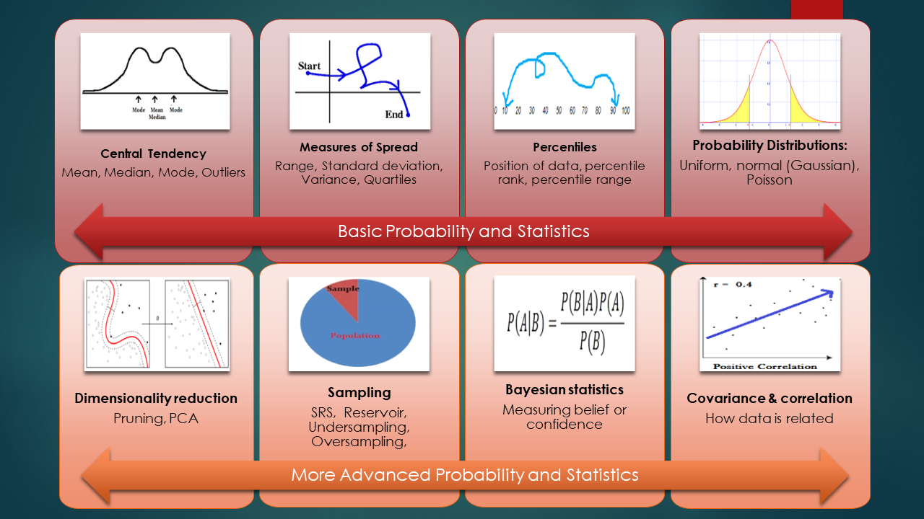

Slide 17
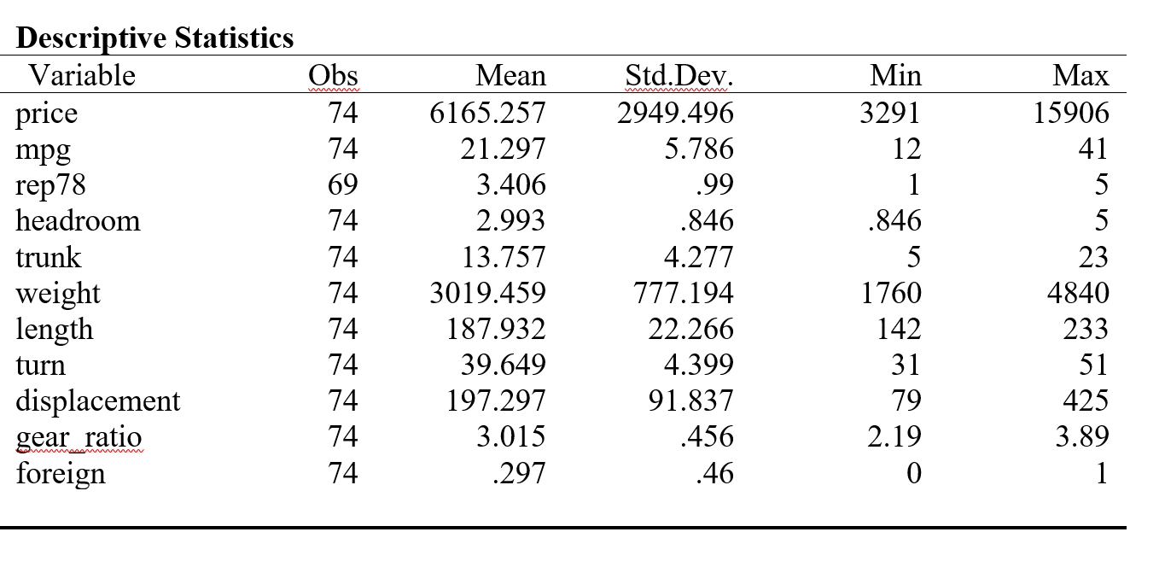
Notes:
Descriptive statistics answer the following questions:
What is the value that best describes the data set?
How much a data set speads from its average value?
What is the smallest and largest number in a data set?
It provides information on summary statistics that includes Mean, Standard Error, Median, Mode, Standard Deviation, Variance, Kurtosis, Skewness, Range, Minimum, Maximum, Sum, and Count.

Slide 18
R Functions for Computing Descriptive Statistics
Description | R function
Mean | mean()
Standard deviation | sd()
Variance | var()
Minimum | min()
Maximum | maximum()
Median | median()
Range of values (minimum and maximum) | range()
Sample quantiles | quantile()
Generic function | summary()
Interquartile range | IQR()
Notes:
Descriptive statistics for a single group
The function mfv(), for most frequent value, [in modeest package] can be used to find the statistical mode of a numeric vector

Slide 19
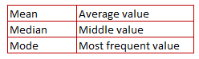
Measure of Central Tendency
When to use mean, median and mode?
Mean – When your data is not skewed i.e. normally distributed. In other words, there are no extreme values present in the data set.
Median – When your data is skewed or you are dealing with ordinal (ordered categories) data (e.g. likert scale 1. Strongly dislike 2. Dislike 3.Neutral 4. Like 5. Strongly like)
Mode - When dealing with nominal (unordered categories) data.
Notes:
Roughly speaking, the central tendency measures the “average” or the “middle” of your data. The most commonly used measures include:
- the mean: the average value. It’s sensitive to outliers.
- the median: the middle value. It’s a robust alternative to mean.
- and the mode: the most frequent value
Mean It is the sum of the observations divided by the sample size. Limitation - It is affected by extreme values. Very large or very small numbers can distort the answer.
Median It is the middle value. It splits the data in half. Half of the data are above the median; half of the data are below the median. Advantage : It is NOT affected by extreme values. Very large or very small numbers does not affect it.
Mode It is the value that occurs most frequently in a dataset. Advantage : It can be used when the data is not numerical. Disadvantage : 1. There may be no mode at all if none of the data is the same 2. There may be more than one mode

Slide 20
Measures of Dispersion: Measures of variability gives how “spread out” the data are
Notes:
Which measure to use?
Range. It’s not often used because it’s very sensitive to outliers.
Interquartile range. It’s pretty robust to outliers. It’s used a lot in combination with the median.
Variance. It’s completely uninterpretable because it doesn’t use the same units as the data. It’s almost never used except as a mathematical tool
Standard deviation. This is the square root of the variance. It’s expressed in the same units as the data. The standard deviation is often used in the situation where the mean is the measure of central tendency.
Median absolute deviation. It’s a robust way to estimate the standard deviation, for data with outliers. It’s not used very often.
Range It is simply the largest observation minus the smallest observation. Advantage: It is easy to calculate. Disadvantage: It is very sensitive to outliers and does not use all the observations in a data set.
Standard Deviation It is a measure of spread of data about the mean. Advantage : It gives a better picture of your data than just the mean alone. Disadvantage :
1. It doesn't give a clear picture about the whole range of the data. 2. It can give a skewed picture if data contain outliers.
Skewness It is a measure of symmetry. A distribution is symmetric if it looks the same to the left and right of the center point.
Kurtosis It is a measure of whether the data are peaked or flat relative to the rest of the data. Higher values indicate a higher, sharper peak; lower values indicate a lower, less distinct peak.
Examples:
Example 1: Suppose you are asked to calculate the average asset value of top stock funds and check whether there is any variability in the assets of these stock funds. You would answer this question with a measure of central tendency and variability. Example 2: Suppose you are asked to provide a figure that best describes the annual salary offered to students in ABC College. You would answer this question with a measure of central tendency and variability.

Slide 21
Computing an overall summary
Summary of a single variable.
Summary() : Provides back five values.
Summary of a data frame.
Summary() : The function automatically is applied to each column
> summary(cars)
speed dist
Min. : 4.0 Min. : 2.00
1st Qu.:12.0 1st Qu.: 26.00
Median :15.0 Median : 36.00
Mean :15.4 Mean : 42.98
3rd Qu.:19.0 3rd Qu.: 56.00
Max. :25.0 Max. :120.00

Slide 22
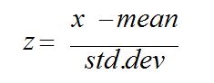
Methods of Standardization / Normalization
1. Z-score:
2. Min-Max Scaling: x-min(x)/max(x)-min(x))
3. Standard Deviation Method: x/stdev(x)
4. Range: x /(max(x) - min(x))
5. Centering: Subtracting a constant value from every value of a variable. The constant value can be average, min or max.
Notes:
See the standardization in R.R
This discussion starts when continuous independent variables are measured at different scales.
Normalization itself can include multiple procedures in general: min-max normalization and Z-score standardization.
Not to be confused though, the min-max normalization method is indeed normalization, when we rescale values to be in the range between 0 and 1.
Whereas Z-score standardization is a procedure to “standardize” data to have mean = 0 and standard deviation = 1.
These are two different procedures and not to be confused since they are used for different purposes and lead to different results.
The idea is to rescale an original variable to have equal range and/or variance.
2. min-max - It is also called 0-1 scaling because the standardized value using this method lies between 0 and 1.
library(dplyr) mins= as.integer(summarise_all(X, min)) rng = as.integer(summarise_all(X, function(x) diff(range(x)))) X.scaled = data.frame(scale(X, center= mins, scale=rng))
3. Std we divide each value by the standard deviation. The idea is to have equal variance, but different means and ranges
# Creating a sample data set.seed(123) X =data.frame(k1 = sample(100:1000,1000, replace=TRUE), k2 = sample(10:100,1000, replace=TRUE)) X.scaled = scale(X, center= TRUE, scale=TRUE)
When it is important to standardize variables?
It is important to standardize variables before running Cluster Analysis. It is because cluster analysis techniques depend on the concept of measuring the distance between the different observations we're trying to cluster.
Prior to Principal Component Analysis, it is critical to standardize variables. It is because PCA gives more weightage to those variables that have higher variances than to those variables that have very low variances.

Slide 23
# Creating a sample data
set.seed(272) X =data.frame(k1 = sample(100:1000,1000, replace=TRUE), k2 = sample(10:100,1000, replace=TRUE)) X.scaled = scale(X, center= TRUE, scale=TRUE)
#Check Mean and Variance of Standardized Variable
colMeans(X.scaled)
var(X.scaled)
Notes:
In scale() function, center= TRUE implies subtracting the mean from its original variable.
The scale = TRUE implies dividing the centered column by its standard deviations.
Interpretation
A value of 1 implies that the value for that case is one standard deviation above the mean, while a value of -1 indicates that a case has a value one standard deviations lower than the mean.
Important to note here: The standardized values do not lie in a particular interval. It can be any real number.

Slide 24
Exercise: Cars
Load sample dataset: cars
Basic scale() command description
Standardize data in R
Visualization of standardized data in R
Notes:
View the data
Range(speed). Range(distance)
Plot(speed,distance)

Slide 25
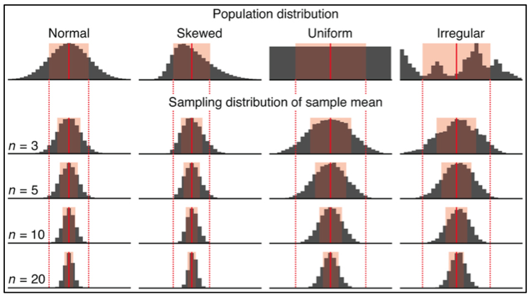
Notes:
1. The distribution of sample means seems to have the same center as the distribution of individual values, and
2. The variation in the distribution of sample means is much less than the original distribution. (In other words, the distribution of sample means is much skinnier than the distribution of individual values.)

Slide 26
Random Variables
1. Generate random numbers from uniform distribution
runif(n, min=a, max=b)
2. Generate random numbers from normal distribution
rnorm(n, mean=a, sd=b)
3. Generate random numbers from binomial distribution
rbinom (# observations, # trails/observation, probability of success )
4. Generate random numbers from bernoulli distribution
rbinom(10, 1,.5)
Notes:
Use the round() function x<-round(x)
2. Key feature ign bell shapred, the Mean=mode=median, 1 std dev from the mean is 68% of the observations, 2 std (95), 3 std(99)
n refers to how many random numbers to generate. a and b are the mean and standard deviation of the distribution respectively.
The default values for mean and standard deviations are 0 and 1.
3. Binomial probability is useful in business analysis.
# r binomial - binomial simulation in r
rbinom(7, 150,.05)
4. We can model individual Bernoulli trials as well. We do this be setting the trials attribute to one. Here is the outcome of 10 coin flips:
Or stepping it up a bit, here’s the outcome of 10 flips of 100 coins:
# binomial simulation in r rbinom(10, 100,.5)

Slide 27
Standard probability density function for the binomial distribution:
#If we flip a fair coin 10 times, what is the probability of getting exactly 5 heads? (a fair coin (p(head)=.5))
> Dbinom(5, size=10, prob=0.5) #calculate binomial probability
# cumulative probability of getting X successes
# If we flip a fair coin 10 times, what is the probability of getting 5 or less heads?
> Pbinom(5,10,0.5)
There is a difference between pbinom and dbinom!!
Notes:
use R’s dbinom function. You can use this to calculate the probability of getting X successes on n binomial trials.
The example above indicates the probability of getting 5 heads in 10 coin flips is just under 25%.
Dbinom provides the probability of getting a result for that specific point on the binomial distribution. Pbinom calculates the cumulative probability of getting a result equal to or below that point on the distribution.

Slide 28
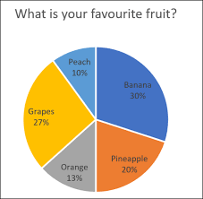
Graphical Display of Distributions: pie chart
graphically depicting groups of numerical data through their quartiles
The basic syntax to create a pie chart in R:
pie(x, labels, radius, main, col, clockwise)
# Create data for the graph.
x <- c(21, 62, 10, 53)
labels <- c("London", "New York", "Singapore", "Mumbai")
pie(x,labels)
.
Notes:
x is a vector containing the numeric values used in the pie chart.
labels is used to give description to the slices.
radius indicates the radius of the circle of the pie chart.(value between −1 and +1).
main indicates the title of the chart.
col indicates the color palette.
clockwise is a logical value indicating if the slices are drawn clockwise or anti clockwise.
Live Demo
# Create data for the graph. x <- c(21, 62, 10, 53)
labels <- c("London", "New York", "Singapore", "Mumbai")
# Give the chart file a name. png(file = "city.png")
# Plot the chart. pie(x,labels)
# Save the file. dev.off()
Slice Percentages and Chart Legend
We can add slice percentage and a chart legend by creating additional chart variables.
Live Demo
# Create data for the graph. x <- c(21, 62, 10,53) labels <- c("London","New York","Singapore","Mumbai") piepercent<- round(100*x/sum(x), 1) # Give the chart file a name. png(file = "city_percentage_legends.jpg") # Plot the chart. pie(x, labels = piepercent, main = "City pie chart",col = rainbow(length(x))) legend("topright", c("London","New York","Singapore","Mumbai"), cex = 0.8, fill = rainbow(length(x))) # Save the file. dev.off()

Slide 29
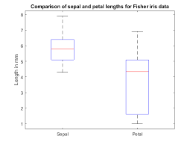
Graphical Display of Distributions: boxplot
graphically depicting groups of numerical data through their quartiles
The basic syntax to create a boxplot in R:
boxplot(x, data, notch, varwidth, names, main)
#Use the default “cars” dataset
#Plot the chart.
boxplot(mpg ~ cyl, data = mtcars, xlab = "Number of Cylinders",
ylab = "Miles Per Gallon", main = "Mileage Data")
.
Notes:
# Give the chart file a name.
png(file = "boxplot.png")
# Save the file.
dev.off()
# Plot the chart.
boxplot(mpg ~ cyl, data = mtcars, xlab = "Number of Cylinders", ylab = "Miles Per Gallon", main = "Mileage Data", notch = TRUE, varwidth = TRUE, col = c("green","yellow","purple"), names = c("High","Medium","Low") )
x is a vector or a formula.
data is the data frame.
notch is a logical value. Set as TRUE to draw a notch.
varwidth is a logical value. Set as true to draw width of the box proportionate to the sample size.
names are the group labels which will be printed under each boxplot.
main is used to give a title to the graph

Slide 30
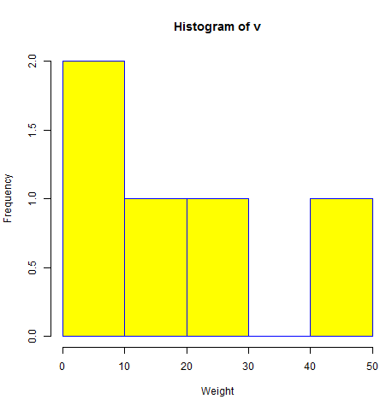
Graphical Display of Distributions: histogram
Histograms show the number of observations that fall within specified divisions (i.e., bins).
The basic syntax for creating a histogram using R:
hist(v,main,xlab,xlim,ylim,breaks,col,border)
# Create data for the graph.
v <- c(9,13,21,8,36,22,12,41,31,33,19)
# Create the histogram.
hist(v,xlab = "Weight",col = "yellow",border = "blue")
Notes:
Following is the description of the parameters used −
v is a vector containing numeric values used in histogram.
main indicates title of the chart.
col is used to set color of the bars.
border is used to set border color of each bar.
xlab is used to give description of x-axis.
xlim is used to specify the range of values on the x-axis.
ylim is used to specify the range of values on the y-axis.
breaks is used to mention the width of each bar.
Live Demo
# Create data for the graph. v <- c(9,13,21,8,36,22,12,41,31,33,19)
# Give the chart file a name. png(file = "histogram_lim_breaks.png")
# Create the histogram. hist(v,xlab = "Weight",col = "green",border = "red", xlim = c(0,40), ylim = c(0,5), breaks = 5)
# Save the file. dev.off()

Slide 31
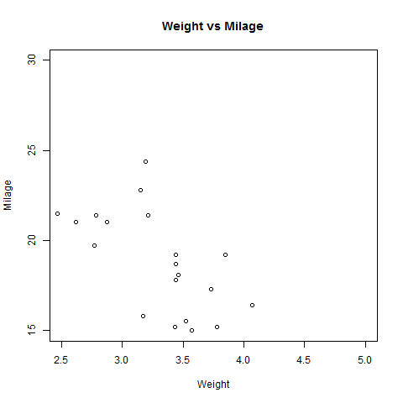
Graphical Display of Distributions: scatterplot
Scatterplots show many points plotted in the Cartesian plane. Each point represents the values of two variables. One variable is chosen in the horizontal axis and another in the vertical axis.
The basic syntax for creating a scatterplot using R:
plot(x, y, main, xlab, ylab, xlim, ylim, axes)
# Plot the chart for cars with weight between 2.5 to 5 and mileage between 15 and 30.
plot(x = input$wt,y = input$mpg,
xlab = "Weight", ylab = "Milage",
xlim = c(2.5,5), ylim = c(15,30),
main = "Weight vs Milage"
)
Notes:
Following is the description of the parameters used −
Following is the description of the parameters used −
x is the data set whose values are the horizontal coordinates.
y is the data set whose values are the vertical coordinates.
main is the tile of the graph.
xlab is the label in the horizontal axis.
ylab is the label in the vertical axis.
xlim is the limits of the values of x used for plotting.
ylim is the limits of the values of y used for plotting.
axes indicates whether both axes should be drawn on the plot.

Slide 32
Graphical Display of Distributions: Barplot
#Bars displayed with values on top set.seed(27222) # Create random example data data <- data.frame(x = sample(LETTERS[1:5], 100, replace = TRUE)) head(data) # Print first lines of data Install.packages(ggplot) Library(ggplot) data_srz <- as.data.frame(table(data$x)) # Summarize data data_srz # Print summarized data ggplot(data_srz, aes(x = Var1, y = Freq, fill = Var1)) + geom_bar(stat = "identity") + geom_text(aes(label = Freq), vjust = 0) #Plot with values on top

Slide 33
Graphical Display of Distributions: ECDF
ECDF is the fraction of data smaller than or equal to x. The basic syntax is ecdf(x).
> set.seed(19191) # Set seed for reproducibility
> x <- rnorm(50) # Normal distribution with 50 values
> ecdf(x) # Compute ecdf values
> plot(ecdf(x)) # Create ecdf plot in R
Notes:
Empirical cumulative distribution function (ECDF)
ECDF is the fraction of data smaller than or equal to x.
calculate the ECDF values of our example data
The RStudio output of the ecdf function is not really helpful, but however, we can also use this output to plot the ECDF:

Slide 34
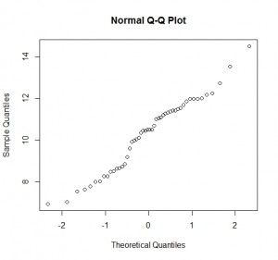
Graphical Display of Distributions: Q-Q plots
Quantile-quantile plots is used to check whether the data is normally distributed. A Q-Q plot is a scatterplot created by plotting two sets of quantiles against one another.
In R, there are two functions to create Q-Q plots: qqnorm and qqplot.
# Creates a standard Normal distribution from 0.01 to 0.99 by increments of 0.01
qnorm(seq(0.01,0.99,0.01))
quantile(rnorm(200),probs = seq(0.01,0.99,0.01))
y <- qunif(ppoints(length(randu$x)))
qqplot(randu$x,y)
Notes:
is a graphical tool to help us assess if a set of data plausibly came from some theoretical distribution such as a Normal or exponential. For example, if we run a statistical analysis that assumes our dependent variable is Normally distributed, we can use a Normal Q-Q plot to check that assumption.
the quantile function in R offers 9 different quantile algorithms!
If both sets of quantiles came from the same distribution, we should see the points forming a line that’s roughly straight.
Now what are “quantiles”? These are often referred to as “percentiles”. These are points in your data below which a certain proportion of your data fall. For example, imagine the classic bell-curve standard Normal distribution with a mean of 0. The 0.5 quantile, or 50th percentile, is 0. Half the data lie below 0.
The following R code generates the quantiles for a standard Normal distribution from 0.01 to 0.99 by increments of 0.01:
qnorm(seq(0.01,0.99,0.01))
Q-Q plots take your sample data, sort it in ascending order, and then plot them versus quantiles calculated from a theoretical distribution. The number of quantiles is selected to match the size of your sample data. While Normal Q-Q Plots are the ones most often used in practice due to so many statistical methods assuming normality, Q-Q Plots can actually be created for any distribution.
First we plot a distribution that’s skewed right, a Chi-square distribution with 3 degrees of freedom, against a Normal distribution.
qqplot(qnorm(ppoints(30)), qchisq(ppoints(30),df=3))

Slide 35
Frequency tables: Used to describe categorical variables
You can generate frequency tables using:
the table( ) function
tables of proportions using the prop.table( ) function, and
marginal frequencies using margin.table( ).
Compute table margins and relative frequency
table(x)
margin.table(x, margin = NULL)
prop.table(x, margin = NULL)
Notes:
A frequency table (or contingency table) is used to describe categorical variables. It contains the counts at each combination of factor levels.
For a contingency table in array form, compute the sum of table entries for a given index.
Prop.tables expresses Table Entries as Fraction of Marginal Table
Three are described below. In the following examples, assume that A, B, and C represent categorical variables.

Slide 36
Frequency tables: Used to describe categorical variables
#Run this example:
> m <- matrix(1:4, 2)
> margin.table(m, 1)
> margin.table(m, 2)
> prop.table(m, 1)

Slide 37
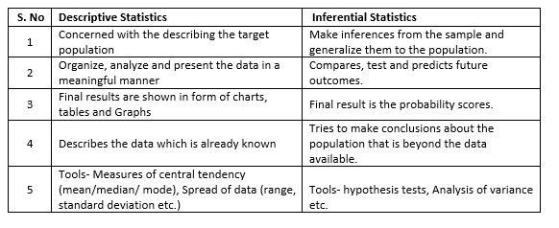
The area of descriptive statistics is concerned with meaningful and efficient ways of presenting data. When it comes to inferential statistics, though, our goal is to make some statement about a characteristic of a population based on what we know about a sample drawn from that population.
Notes:
Descriptive Statistics: collection, presentation, and description of sample data.
Inferential Statistics: making decisions and drawing conclusions about populations.
The area of descriptive statistics is concerned with meaningful and efficient ways of presenting data.
When it comes to inferential statistics, though, our goal is to make some statement about a characteristic of a population based on what we know about a sample drawn from that population.
Generally speaking, there are two kinds of statements one can make.
parameter estimation
hypothesis testing

Slide 38
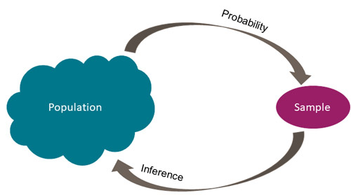
Inferential statistics
Notes:
descriptive statistics are used to summarize a sample or information about the sample. Inferential statistics, on the other hand, are used to make inferences or g
Inferential statistics are used to test hypotheses about the relationship between the independent and the dependent variables.
Inferential statistics allow you to test your hypothesis
When you get a statistically significant result using inferential statistics, you can say that it is unlikely (in social sciences this is 5%) that the relationship between variables is due to chance.
eneralizations about the broader population.

Slide 39
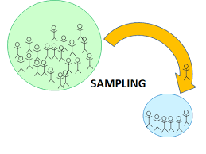
Notes:
Probability Sampling
The main difference between a population and sample has to do with how observations are assigned to the data set.
A population includes all of the elements from a set of data.
A sample consists one or more observations drawn from the population.
Depending on the sampling method, a sample can have fewer observations than the population, the same number of observations, or more observations. More than one sample can be derived from the same population.

Slide 40
Ex. Dimension of Matrix or Data Frame
> set.seed(8212) # Set Seed for reproducibility
> N <- 500 # Sample size
> x1 <- round(rnorm(N, 1, 20)) # Create 5 random variables
> x2 <- round(runif(N, 5, 10))
> x3 <- round(runif(N, 1, 4), 1)
> x4 <- round(runif(N, 5, 50))
> x5 <- rpois(N, 5)
x1 x2 x3 x4 x5
1 29 6 2.5 6 8
2 26 8 1.1 47 6
3 -7 6 3.9 38 5
4 -11 6 1.1 33 7
5 17 7 1.7 27 4
6 -11 7 3.0 41 6
Notes:
500 observations with 5 columns
Run these basic statistics on this data frame
Dim(data)
In case you want to get the number of entries of a vector, you have to use the length function:
data_matrix <- as.matrix(data) # Convert data.frame to matrix
dim(data_matrix) # Apply dim function to matrix

Slide 41
The sampling process comprises several stages:
Define the population of concern
Specify a sampling frame, a set of items or events possible to measure
Specify a sampling method for selecting items or events from the frame
Determine the sample size
Implement the sampling plan
Sample and collect data

Slide 42
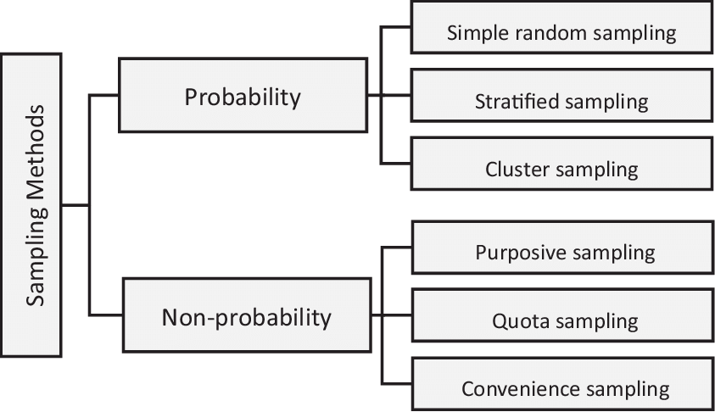
Notes:
imple random sampling is a completely random method of selecting subjects. These can include assigning numbers to all subjects and then using a random number generator to choose random numbers. Classic ball and urn experiments are another example of this process (assuming the balls are sufficiently mixed). The members whose numbers are chosen are included in the sample.
Stratified Random Sampling involves splitting subjects into mutually exclusive groups and then using simple random sampling to choose members from groups.
Systematic Sampling means that you choose every “nth” participant from a complete list. For example, you could choose every 10th person listed.
Cluster Random Sampling is a way to randomly select participants from a list that is too large for simple random sampling. For example, if you wanted to choose 1000 participants from the entire population of the U.S., it is likely impossible to get a complete list of everyone. Instead, the researcher randomly selects areas (i.e. cities or counties) and randomly selects from within those boundaries.
Multi-Stage Random sampling uses a combination of techniques.

Slide 43
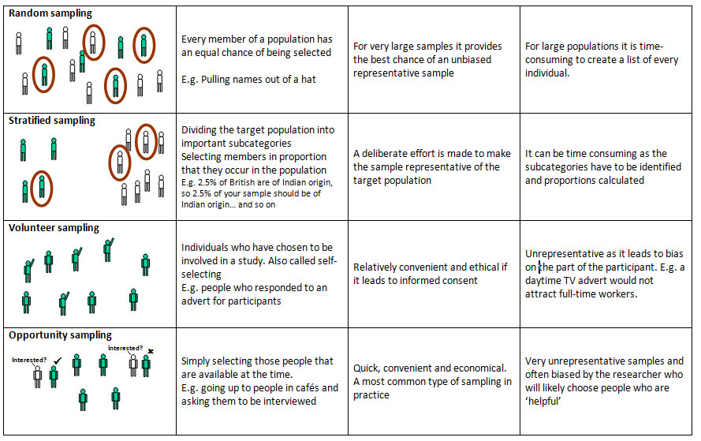
Notes:
There are various sampling methods. The one chosen will depend on a number of factors (such as time, money etc.).
Probability Sampling:
Sample has a known probability of being selected.
Individuals are sampled independently of each other.
Known as random sampling
Non-probability (Judgement) Sampling:
Convenience sampling (voluntary response surveys)
Refers to when researchers take whatever individuals happen to be easiest to access as participants in a study
Simple Random Sampling (SRS)
Stratified Sampling
Cluster Sampling
Systematic Sampling
Multistage Sampling (above methods are combined in stages)
stratified sampling
Reduces sampling error by gaining greater control over the composition of the sample
Ensures small group within a population is adequately represented in a sample
Con – must have data on the characteristics of the population
cluster sampling
Used on very large sample, not necessary to have data on important variables for entire population.
Ordinally used to reduce costs
Con – produces less representative samples
systematic
More practical with time and resources compared to simple random sampling
Can be bias if the sample frame from which the sample is selected is ordered is some kind of systematic fashion that influences composition

Slide 44
(Simple) Random Sampling
A sample selected in such a way that every element in the population has a equal probability of being chosen.
Equivalently, all samples of size n have an equal chance of being selected.
Obtained either by sampling with replacement from a finite population or by sampling without replacement from an infinite population.
Inherent in the concept of randomness: the next result (or occurrence) is not predictable.
Proper procedure for selecting a random sample: use a random number generator or a table of random numbers
Assumed when performing conventional statistical analyses
No guarantee of a representative sample
May not be feasible (e.g., costly, impractical)

Slide 45
Stratified Sampling (Proportional Sample)
Population gets partitioned into groups based on a factor that may influence the variable that is being measured.
These groups called strata.
An individual group is called a stratum.
To perform stratified sampling:
Partition the population into groups (strata)
Obtain a simple random sample from each group (stratum)
Collect data on each sampling unit that was randomly sampled from each group (stratum)
Works best when a heterogeneous population is split into fairly homogeneous groups.
Generally produces more precise estimates of the population percents than estimates that would be found from a simple random sample. More control over representativeness. Allows for intentional oversampling which permits greater statistical precision (i.e., decreases standard errors).
Must have data on the characteristics of the population in order to select the sample.

Slide 46
Cluster Sampling
Stratifying the sampling frame and then selecting some or all of the items from some of, but not all, the strata.
Divide the population into groups (clusters).
Obtain a simple random sample of so many clusters from all possible clusters.
Obtain data on every sampling unit in each of the randomly selected clusters.
Note that, unlike with the strata in stratified sampling, the clusters should be microcosms, rather than subsections, of the population.
Each cluster should be heterogeneous.
Statistical analysis often more complicated than stratified sampling.
Decreases statistical precision (individuals within groups tend to be more similar so we have less unique information)

Slide 47
Syntax for Sample Function in R:
# A single roll of a die is a number between one and six
> set.seed(1)
> sample(1:6, 10, replace=TRUE) #Sample with replacement
> sample(1:6, 10, replace=TRUE)
> set.seed(123) #Setting a seed
> index <- sample(1:nrow(iris), 5)
> index
> iris[index, ]
sample(x, size, replace = FALSE, prob = NULL)

Slide 48
#Stratified sampling
set.seed(1)
> d1 <- data.frame(ID = 1:100, A = sample(c("AA", "BB", "CC", "DD", "EE"), 100, replace = TRUE),
B = norm(100), C = abs(round(rnorm(100), digits = 1)),
D = sample(c("CA", "NY", "TX"), 100, replace = TRUE),
E = sample(c("M", "F"), 100, replace = TRUE))
> summary(d1)
> stratified(d1, "A", 0.1) #A 10% sample from all -A- groups in d1
Notes:
-You tell sample() to return ten values, each in the range 1:6.
-You can use sample() to take samples from the data frame iris. In this case, you may want to use the argument replace=FALSE.

Slide 49
Non-probability Sampling
Sampling types that should be avoided:
Convenience (accidental) – selected on the basis of availability
Quota – selected on the basis of availability with “quotas” being selected to represent the distribution in the population.
Judgmental – researcher selects units he/she thinks are more representative of the population. Every unit is not eligible for inclusion in the sample, personal biases
Snowball – unit with a desired characteristic is identified. This unit then identifies other units with desired characteristics and so on…. (i.e. social networks)
These are referred to as "sampling disasters”.
Biased samples
Based on human choice rather than random selection
Statistical theory cannot explain how they might behave and potential sources of bias are rampant.

Slide 50
Discussion: Variable Selection
How do these limitations impact your selection of data?
Highly predictive variables — the use of which is prohibited by legal, ethical or regulatory rules.
Some, some variables might not be available or might be of poor quality during modeling or production stages.
The business will always have the last word and might insist that only business-sound variables are included or request monotonically increasing or decreasing effects.
Notes:
challenging task to minimize the selection bias
Collaboration with experts in the field to identify the important variables.
Awareness of any problems in relation to data source, reliability or mismeasurement.
Cleaning the data.
Using control variables to account for banned variables or specific events such as an economic drift.

Slide 51
Sampling Challenges
Sampling error - discrepancies between the sample and the population on a certain parameter that are due to random differences; no fault of the researcher.
Systematic error - difference between the sample and the population that is due to a systematic difference between the two rather than random chance alone.
Response rate - sample can become self-selecting, and that there may be something about people who choose to participate in the study that affects one of the variables of interest.
Coverage error - refers to the fact that sometimes researchers mistakenly restrict their sampling frame to a subset of the population of interest
*The more participants a study has, the less likely the study is to suffer from sampling error.
Notes:
Where do you see these challenges in your data?
Survey
Lab reports
nonsampling errors
Using an incomplete population
Nonresponse
Interviewer errors
Misrepresented answers
Mistakes in recording or entering data
Questionnaire design
Wording of questions
Order of questions, words, and responses

Slide 52
Motivation . . .
The purpose of hypothesis testing is to determine whether there is enough statistical evidence in favor of a certain belief, or hypothesis, about a parameter.

Slide 53
It is a 7-step process:
Make Assumptions.
Take an initial position.
Determine the alternate position.
Set acceptance criteria
Conduct fact based tests.
Evaluate results. Does the evaluation support the initial position? Are we confident that the result is not due to chance?
Reach one of the following conclusion: Reject the original position in favor of alternate position or fail to reject the initial position.
Notes:
Let’s recall…

Slide 54
Example
Consider a person on trial for a “criminal” offense in the United States. Under the US system a jury (or sometimes just the judge) must decide if the person is innocent or guilty while in fact the person may be innocent or guilty.
 |  |  | Person Is:
 |  |  | Innocent | Guilty
Jury Says: |  | Innocent | No Error | Error
 |  | Guilty | Error | No Error
There is a favored assumption, an initial bias. The jury is instructed to
assume the person is innocent.

Slide 55
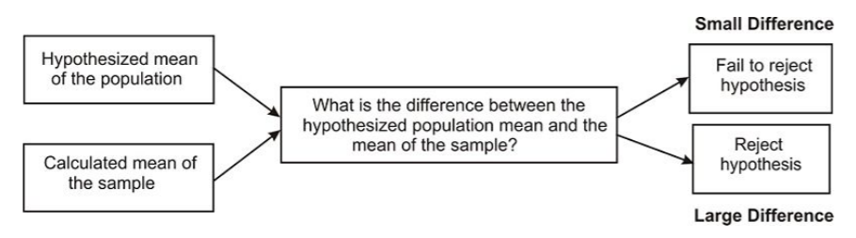
Notes:
Under the null hypothesis of µ = 0, the sampling distribution of the mean has a mean of 0 and a standard deviation of sigma/sqrt(n).
Under the alternative hypothesis of µ = delta, the sampling distribution of the mean has a mean of delta and the standard deviation is equal to that of the null distribution.
Sigma/sqrt(n) is called the standard error of the mean, which is simpler than saying the standard deviation of the sampling distribution of the sample mean.

Slide 56
Hypothesis Testing
You have sample data and you are asked to assess the credibility of a statement about population using sample data.
Put the hypo test image here
Notes:
we use a random sample of data taken from a population to describe and make inferences about the population.
Statistical significance evaluates the likelihood that an observed (actual) difference is due to chance.
Independent T-Test
The independent t test evaluates whether the means for two independent groups are significantly different from each other. It is used for just 2 groups of samples. If you have more than 2 groups of samples, you should use ANOVA. Assumptions
Each score is sampled independently and randomly.
The scores are normally distributed within each of the two groups.
The variance in each of the groups is equal.
Null Hypothesis
It is a statement that you want to test. It usually states that there is no relationship between the two variables. In this case, the null hypothesis states that there is no difference between the mean ratings of the charismatic-teacher-reputation condition and the punitive-teacher-reputation condition.Alternate Hypothesis
It is contrary to the null hypothesis. It usually states that there is a relationship between the two variables.
What is p-value in simple terms?
P-value evaluate how well the sample data support that the null hypothesis is true. A low P value means that your sample provides enough evidence that you can reject the null hypothesis for the entire population. In technical language, it means lowest level of significance at which you can reject the null hypothesis.
Type I and II Errors Examples
1. Let's say you are testing a new drug for some disease. Null Hypothesis : New Drug has no effect on disease. In a test of its effectiveness, a type I error would be to say it has an effect when it does not (False Positive) ; a type II error would be to say it has no effect when it does (False Negative).

Slide 57
Recall the Central Limit Theorem:
Using this, we determine if our assumption for the null hypothesis (H0) is reasonable or not. If it is unlikely, by the Rare Event rule, our hypothesis is probably incorrect (i.e. reject H0).
In general, we use the following:
If the test sample yields an unlikely result, it is probably incorrect (reject H0)
If the test sample yields a likely result, it is probably correct (fail to reject H0)

Slide 58
There is an extremely close relationship between confidence intervals and hypothesis testing.
When a 95% confidence interval is constructed, all values in the interval are considered plausible values for the parameter being estimated. Values outside the interval are rejected as relatively implausible.
The confidence interval tells you more than just the possible range around the estimate. It also tells you about how stable the estimate is.
If exact p-value is reported, then the relationship between confidence intervals and hypothesis testing is very close. However, the objective of the two methods is different: Hypothesis testing relates to a single conclusion of statistical significance vs. no statistical significance.

Slide 59
Probability theory: Allows us to calculate the exact probability that chance was the real reason for the relationship.
Probability theory allows us to produce test statistics (using mathematical formulas)
A test statistic is a number that is used to decide whether to accept or reject the null hypothesis.
The most common statistical tests include:
Chi-square
T-test
ANOVA
Correlation
Linear Regression

Slide 60
Create Sample Data in R
#Define Sample 1 smp2014 <- c(222, 823, 1092, 400, 948, 836)
#Define Sample 2 smp2019 <- c(910, 650, 700, 892, 229, 1051)
#Two sample T-test
t.test(smp2014, smp2018, var.equal=FALSE)
#What is the p-value?
#Run Welch's T-test of Equal Variance
t.test(smp2014, smp2019, var.equal=TRUE)
Notes:
Two Sample t-test data: smp2014 and smp2019 t = -0.10213, df = 10, p-value = 0.9207 alternative hypothesis: true difference in means is not equal to 0 95 percent confidence interval: -422.1094 385.1094
sample estimates: mean of x mean of y 720.1667 738.6667
Let’s use Welch's t-test - it performs better than Student's t-test whenever sample sizes and variances are unequal between groups, and gives the same result when sample sizes and variances are equal.
How to calculate t-test and p-value manually
xhat1 <- mean(batch2009)
xhat2 <- mean(batch2015)
s1 <- sd(batch2009)
s2 <- sd(batch2015)
n1 <- length(batch2009)
n2 <- length(batch2015)
diff_in_means <- xhat1 - xhat2
SE_diff_mean <- sqrt(s1^2/n1+s2^2/n2)
t_stat <- diff_in_means/SE_diff_mean
t_stat
pvalue = 2* pt(t_stat, df=n1+n2-2)
pvalue
#run Levene Test for Equality of Variance
temp = rbind(data.frame(x=batch2009, group=1), data.frame(x=batch2015, group=2)) temp$group = as.factor(temp$group) library(car) leveneTest(temp$x, group = temp$group, center = mean)

Slide 61
Conditions for a 1 sample z-test
A one sample z test is one of the most basic types of hypothesis test.
Normality -normal population. Data roughly fits a bell curve shape. Central Limit Theorem (n≥30)
Graphing - Qplots/box plots/normal probability
2. Independence - population is greater than 10 times the sample size (N≥10n)
Null hypothesis for a 1 sample z-test
The mean of a population is equal to the sample mean µ = µ_0n
Alternative hypotheses for a 1 sample z-test
The mean of a population is (not equal to/less than/greater than) the sample mean µ≠µ_0 OR µ<µ_0 OR µ>µ_0

Slide 62
Conditions for a 2 sample z-test
Both (two) populations are normally distributed Null hypothesis for a 2 sample z-test
The difference between the means of 2 populations is zero (equal means) µ_1 − µ_2 = 0 OR µ_1 = µ_2
Alternative hypotheses for a 2 sample z-test
Population 1 mean is (not equal to/greater than/less than) the population 2 mean

Slide 63
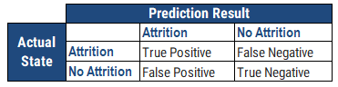
Confusion Matrix
Precision = True Positive / (True Positive + False Positive)
True Positive : Number of customers who actually attrited whom we correctly predicted as attritors.
False Positive : Number of customers who actually did not attrite whom we incorrectly predicted as attritors.
Recall = True Positive / (True Positive + False Negative)
True Positive : Number of customers who actually attrited whom we correctly predicted as attritors.
False Negative: Number of customers who actually attrited whom we incorrectly predicted as non-attritors.
Notes:
Difference between Precision and Recall
The main difference is denominator. In Precision, False Positive is included whereas false negative is considered in recall.
Let's say there are in total 160 customers. Out of 160, 80 customers actually left us (attrited). Out of 80, we correctly predicted 70 of them as attritors. Recall would be 87.5% (70 divided by 80).
Out of total 160 customers, we predicted 130 customers as attritors. Out of 130, we correctly predicted 70 of them as attritors. Precision would be 53.8% (70 divided by 130).

Slide 64
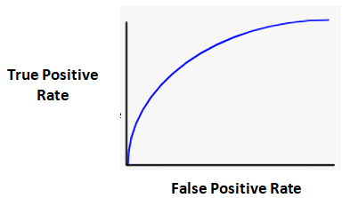
Precision Recall Curve: popular model performance metrics to evaluate binary classification model
Cutoff | 0.9 | 0.75 | 0.6 | 0.5 | 0.4
Recall (X) | 0.14 | 0.41 | 0.69 | 0.88 | 0.90
Precision (Y) | 0.90 | 0.85 | 0.82 | 0.81 | 0.50
#Area under the precision recall area
recall=c(0.14, 0.41, 0.69, 0.88, 0.90)
precision=c(0.90, 0.85, 0.82, 0.81, 0.50)
i = 2:length(recall)
recall = recall[i] - recall[i-1]
precision = precision[i] + precision[i-1]
(AUPRC = sum(recall * precision)/2)
Advantage of using AUPRC over ROC
Notes:
How to calculate area under precision recall curve mathematically?
Once we have precision-recall for different thresholds, we can calculate area under curve using Trapezoidal Rule Numerical Integration.
- In simple words, it adds up all trapezoids under the curve. Make sure the different recall values is sorted before using Trapezoidal Rule.
Note : Trapezoid rule is not the most accurate way of calculating integrals. Simpson's rule is more accurate.
Sas: With the use of PROC IML, we can calculate area under curve

Slide 65
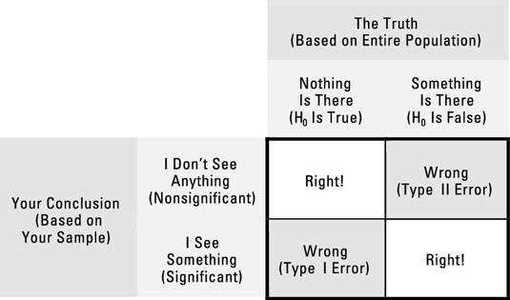
Were you right ? ...
Notes:
Conclusions are sentence answers which include whether there is enough evidence or not (based on the decision), the level of significance, and whether the original claim is supported or rejected. Conclusions are based on the original claim, which may be the null or alternative hypotheses. The decisions are always based on the null hypothesis
I errors
Occurs when the null hypothesis is true, but is rejected. Conclusion is there is an association when there actually is none.
A false positive, is asserting something as true when it is actually false.
Type II errors
Occurs when the null hypothesis is false, but erroneously fails to be rejected. Conclusion is there is no association when there actually is one.
A false negative, is where a test result indicates that a condition failed, while it actually was successful.

Slide 66
Which of the two errors is more serious? Type I or Type II ?
Since Type I is the more serious error (usually), rationale is stick to the status quo or default assumption, at least you're not making things worse. But it depends…
Note: alpha is not a Type I error. Alpha,‘α’, is the probability of committing a Type I error. (i.e. α =.05; 5% is the level of reasonable doubt that you are willing to accept when statistical tests are used to analyze the data after the study is completed.). Likewise beta, ‘β’, is the probability of committing a Type II error. A Type II error relates to the concept of "power,“; having enough power depends on whether the sample size is sufficiently large to detect a difference when it exists.
Although type I and type II errors can never be avoided entirely, the you can reduce the likelihood of occurrence by increasing the sample size (the larger the sample, the lesser is the likelihood that it will differ substantially from the population).
False-positive and false-negative results can also occur because of bias (observer, instrument, recall, etc.). (Errors due to bias, however, are not referred to as type I and type II errors.) Such errors are troublesome, since they may be difficult to detect and cannot usually be quantified.
Notes:
Where do these types show up in your data?
How do you fix them?
Type 1 is via the significance level of a test
https://books.google.com/books?id=gn5WAwAAQBAJ&pg=PA47&lpg=PA47&dq=type+i+or+type+ii+bioinformatics&source=bl&ots=7KLDLEXPH9&sig=ACfU3U26fYo1NcRyVeMXdQoJ81jEm5naZg&hl=en&sa=X&ved=2ahUKEwjcv62cnMbnAhXuYN8KHZ0bB0AQ6AEwEXoECAsQAQ#v=onepage&q=type%20i%20or%20type%20ii%20bioinformatics&f=false

Slide 67
Conclusions are sentence answers which include whether there is enough evidence or not (based on the decision), the level of significance, and whether the original claim is supported or rejected. Conclusions are based on the original claim, which may be the null or alternative hypotheses. The decisions are always based on the null hypothesis
 | Original Claim
Decision | H₀ "REJECT" | H₁ "SUPPORT"
Reject H₀ "SUFFICIENT" | There is sufficient evidence at the alpha level of significance to reject the claim that (insert original claim here) | There is sufficient evidence at the alpha level of significance to support the claim that (insert original claim here)
Fail to reject H₀ "INSUFFICIENT" | There is insufficient evidence at the alpha level of significance to reject the claim that (insert original claim here) | There is insufficient evidence at the alpha level of significance to support the claim that (insert original claim here)

Slide 68
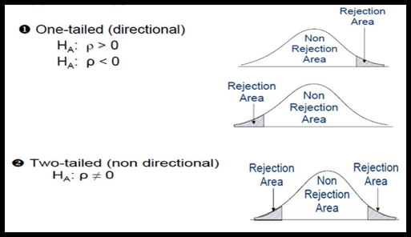
Notes:
Conduct when a priori (knowledge that proceeds from theoretical deduction rather than from observation) the researcher does not know whether the population mean is likely to increase or decrease relative to the (null) hypothesized mean.
The significance level is now split between the upper and lower tails of the null hypothesis distribution and correspondingly both tails comprise the rejection region.
There are two forms of research hypothesis. The critical or rejection region can be one side of the distribution or both sides of the distribution depending on the nature of the research hypothesis. Directional research hypothesis or one tail test has one critical region. On the contrary, the Non-directional research hypothesis or two tail test has two rejection regions on both sides of the distribution.

Slide 69
Distinction between NON-DIRECTIONAL and DIRECTIONAL: Research hypotheses
Non-directional hypotheses
Only state that one group differs from another on some characteristic, i.e., it does NOT specify the DIRECTION of the difference
Example: H0 -- Michigan students differ from the college population in ideological attitudes
Directional hypotheses
Specifies the nature of the difference, i.e., that one group is higher, or lower, than another group on some attribute
Example:
UM students are more conservative than other students = H1
UM students are more liberal than other students = H2

Slide 70
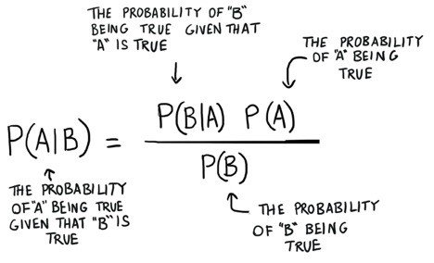
Bayesian

Slide 72
t-test statistic
The t statistic allows researchers to use sample data to test hypotheses about an unknown population mean.
The t statistic is mostly used when a researcher wants to determine whether or not a treatment intervention causes a significant change from a population or untreated mean.
The goal for a hypothesis test is to evaluate the significance of the observed discrepancy between a sample mean and the population mean.
Therefore, the t statistic requires that you use the sample data to compute an estimated standard error of M.
A large value for t (a large ratio) indicates that the obtained difference between the data and the hypothesis is greater than would be expected if the treatment has no effect.

Slide 73
Student’s t-test: Commands and explanation
t.test(data.1, data.2) – The basic method of applying a t-test is to compare two vectors of numeric data.
var.equal = FALSE – If the var.equal instruction is set to TRUE, the variance is considered to be equal and the standard test is carried out. If the instruction is set to FALSE (the default), the variance is considered unequal and the Welch two-sample test is carried out.
mu = 0 – If a one-sample test is carried out, mu indicates the mean against which the sample should be tested.
alternative = “two.sided” – It sets the alternative hypothesis. The default value for this is “two.sided” but a greater or lesser value can also be assigned. You can abbreviate the instruction.
conf.level = 0.95 – It sets the confidence level of the interval (default = 0.95).
paired = FALSE – If set to TRUE, a matched pair T-test is carried out.
t.test(y ~ x, data, subset) – The required data can be specified as a formula of the form response ~ predictor. In this case, the data should be named and a subset of the predictor variable can be specified.
subset = predictor %in% c(“sample.1”, sample.2”) – If the data is in the form response ~ predictor, the two samples to be selected from the predictor should be specified by the subset instruction from the column of the data.

Slide 74
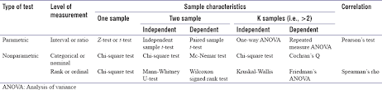
Notes:
It is helpful to decide the input variables and the outcome variables. For example, in a clinical trial the input variable is the type of treatment - a nominal variable - and the outcome may be some clinical measure perhaps Normally distributed. The required test is then the t-test (Table 2). However, if the input variable is continuous, say a clinical score, and the outcome is nominal, say cured or not cured, logistic regression is the required analysis. A t-test in this case may help but would not give us what we require, namely the probability of a cure for a given value of the clinical score. As another example, suppose we have a cross-sectional study in which we ask a random sample of people whether they think their general practitioner is doing a good job, on a five point scale, and we wish to ascertain whether women have a higher opinion of general practitioners than men have. The input variable is gender, which is nominal. The outcome variable is the five point ordinal scale. Each person's opinion is independent of the others, so we have independent data. From Table 2 we should use a χ² test for trend, or a Mann-Whitney U test with a correction for ties (N.B. a tie occurs where two or more values are the same, so there is no strictly increasing order of ranks – where this happens, one can average the ranks for tied values).

Slide 75
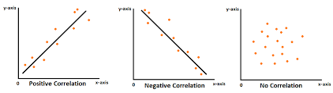

Slide 76
Correlations
A simplified format is cor(x, use=, method= )
# Correlations/covariances among numeric variables in
# data frame mtcars.
# Use listwise deletion of missing data.
> cor(mtcars, use="complete.obs", method="kendall")
> cov(mtcars, use="complete.obs")
#Use corrgram( ) to plot correlograms #Visualizing Correlations
Notes:
The rcorr( ) function in the Hmisc package produces correlations/covariances and significance levels for pearson and spearman correlations. However, input must be a matrix and pairwise deletion is used.

Slide 77
Chi-square
The function used for performing chi-Square test is chisq.test(). The syntax is Chisq.test(data).
> install.libary(“MASS”) #install package
> library (“MASS”) #load library
# Create a data frame from the main data set.
> car.data <- data.frame(Cars93$AirBags, Cars93$Type)
# Create a table with the needed variables.
> car.data = table(Cars93$AirBags, Cars93$Type)
> print(car.data)
# Perform the Chi-Square test.
> print(chisq.test(car.data))
Notes:
The result shows the p-value of less than 0.05 which indicates a string correlation.

Slide 78
Analysis of Variance (ANOVA)
# One Way Anova (Completely Randomized Design)
>fit <- aov(y ~ A, data=mydataframe)
# Randomized Block Design (B is the blocking factor)
>fit <- aov(y ~ A + B, data=mydataframe)
# Two Way Factorial Design
>fit <- aov(y ~ A + B + A:B, data=mydataframe)
>fit <- aov(y ~ A*B, data=mydataframe) # same thing
# Analysis of Covariance
>fit <- aov(y ~ A + x, data=mydataframe)

Slide 79
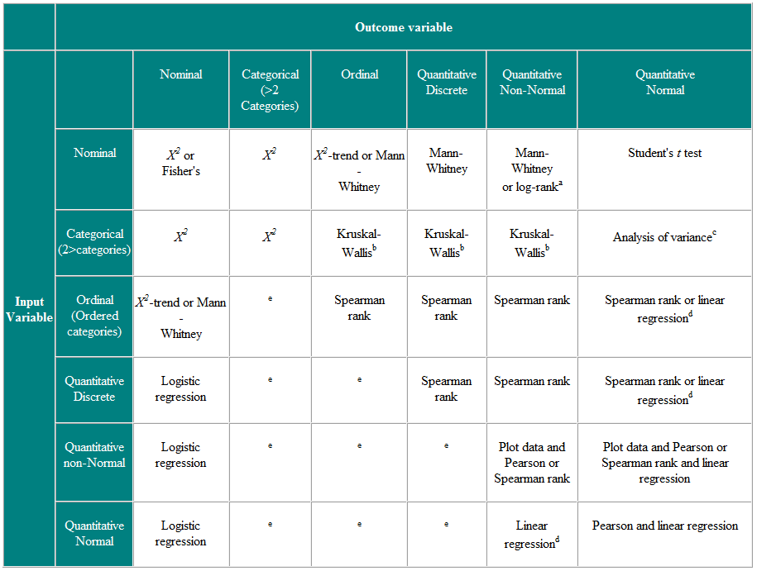
Notes:
It is helpful to decide the input variables and the outcome variables. For example, in a clinical trial the input variable is the type of treatment - a nominal variable - and the outcome may be some clinical measure perhaps Normally distributed. The required test is then the t-test (Table 2). However, if the input variable is continuous, say a clinical score, and the outcome is nominal, say cured or not cured, logistic regression is the required analysis. A t-test in this case may help but would not give us what we require, namely the probability of a cure for a given value of the clinical score. As another example, suppose we have a cross-sectional study in which we ask a random sample of people whether they think their general practitioner is doing a good job, on a five point scale, and we wish to ascertain whether women have a higher opinion of general practitioners than men have. The input variable is gender, which is nominal. The outcome variable is the five point ordinal scale. Each person's opinion is independent of the others, so we have independent data. From Table 2 we should use a χ² test for trend, or a Mann-Whitney U test with a correction for ties (N.B. a tie occurs where two or more values are the same, so there is no strictly increasing order of ranks – where this happens, one can average the ranks for tied values).

Slide 80
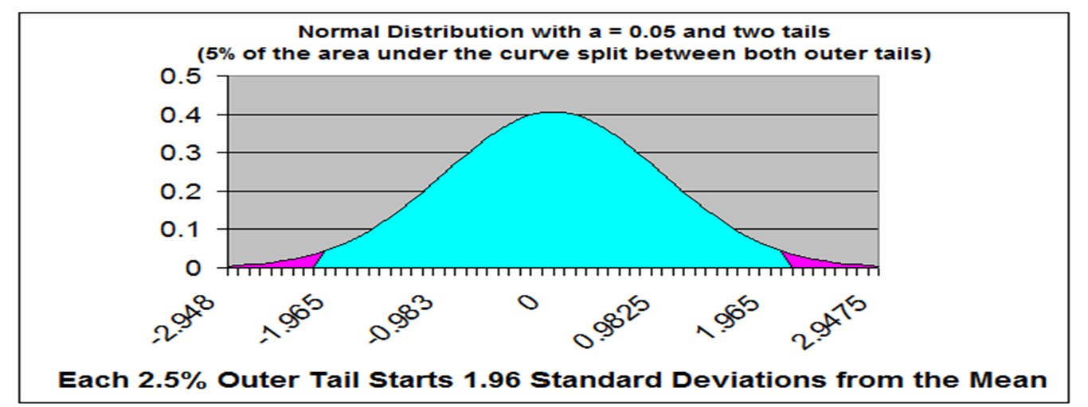
Significance
If the test statistic produced by the statistical test (using a mathematical formula) falls within a specified rejection region on the normal distribution, then we can conclude that the relationship between the independent and dependent variables is unlikely to be due to chance. (rejection = rejection of the NULL hypothesis)
The rejection region is determined by the researcher prior to conducting the statistical test and is called the alpha level.

Slide 81
p Values
Each test statistic has a p value (a probability value) associated with it.
When you plot a test statistic on the normal distribution, the location of the test statistic on the normal distribution is associated with a p value, or a probability.
If the p value produced by the test statistic is within the rejection region on the normal distribution, then you reject the null hypothesis and conclude that there is a relationship between the independent and the dependent variables. This shows statistical significance.

Slide 82
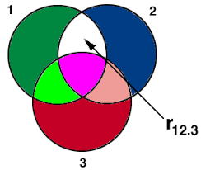
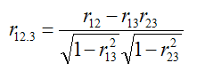
Partial Correlation
Partial Correlation measures relationship between two variables (X,Y) while eliminating influence of a third variable (Z).
Called “correlation” but it is actually regression. It requires estimation of variances.
# Partial correlation
library(ppcor) with(mydata, pcor.test(Height,Weight,Age))
Notes:
r12.3 is the correlation between variables x1 and x2 keeping x3 constant
Example - Relationship between weight and number of meals intake while controlling age
# Load Library library(ppcor) # Read data mydata=read.csv("C:\\Users\\Deepanshu\\Documents\\Example1.csv") # Partial correlation between "height" and "weight" given "age" with(mydata, pcor.test(Height,Weight,Age))
R Script : Semipartial Correlation Coefficient Semi partial correlation - Age constant for Weight only with(mydata, spcor.test(Height,Weight,Age))

Slide 83
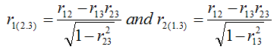
Semi-partial Correlation
Semi-partial correlation measures the strength of linear relationship between variables X1 and X2 holding X3 constant for just X1 or just X2. It is also called part correlation.
#Semipartial Correlation Coefficient
with(mydata, spcor.test(Height,Weight,Age))
#Semi partial correlation - Age constant for Weight only
Notes:
Semipartial correlation holds variable X3 for only one variable (either X1 or X2).
Assumptions : Partial and Semipartial Correlation Variables should be continuous in nature. For example, weight, GMAT score, sales etc
There should be linear relationship between all the three variables. If a variable has non-linear relationship, transform it or ignore the variable.
There should be no extreme values (i.e outliers). If outliers are present, we need to treat them either by percentile capping or remove the outlier observations
Variables you want to hold constant can be one or more than one

Slide 84
Testing for Normality
Plotting returns in R plot(x$s) or ggplot
Kolmogorov-Smirnov test in R ks.test(x$s, "pnorm", mean=mean(x$r), sd=sd(x$r))
Shapiro-Wilk test in R shapiro.test(x$columnname)
Jarque-Bera test in R install.packages("tseries")
ibrary(tseries)
jarque.bera.test(x$columnname)
#import the data
View(rtns)
#data wrangle and select a column from a dataframe (use select())
Notes:
Fix the codes to match dataset name
K-S: One of the most frequently used tests for normality in statistics is the Kolmogorov-Smirnov test (or K-S test).
we want to test for normality in R, therefore the theoretical distribution we will be comparing our data to is normal distribution.
It is important that this distribution has identical descriptive statistics as the distribution that we are are comparing it to (specifically mean and standard deviation.
The null hypothesis of the K-S test is that the distribution is normal.
Therefore, if p-value of the test is >0.05, we do not reject the null hypothesis and conclude that the distribution in question is not statistically different from a normal distribution.
S-W: The procedure behind the test is that it calculates a W statistic that a random sample of observations came from a normal distribution.
Similar to Kolmogorov-Smirnov test (or K-S test) it tests the null hypothesis is that the population is normally distributed.
The S-W test is used more often than the K-S as it has proved to have greater power when compared to the K-S test.
The J-B test focuses on the skewness and kurtosis of sample data and compares whether they match the skewness and kurtosis of normal distribution.
R doesn't have a built in command for J-B test, therefore we will need to install an additional package.

Slide 85
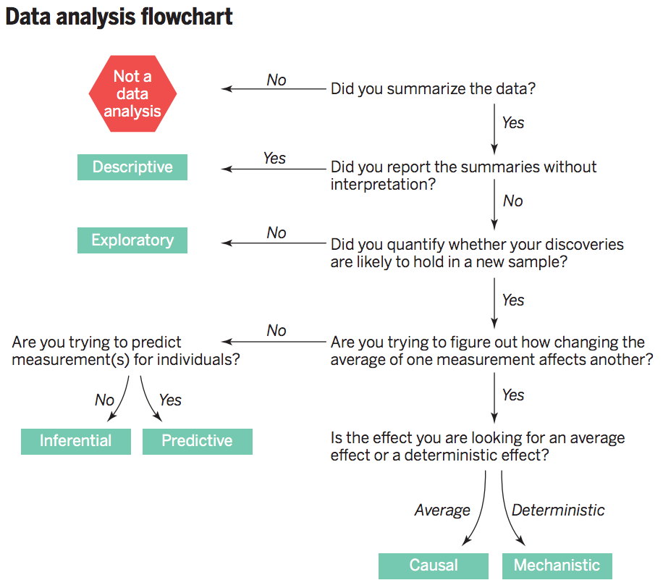

Slide 86
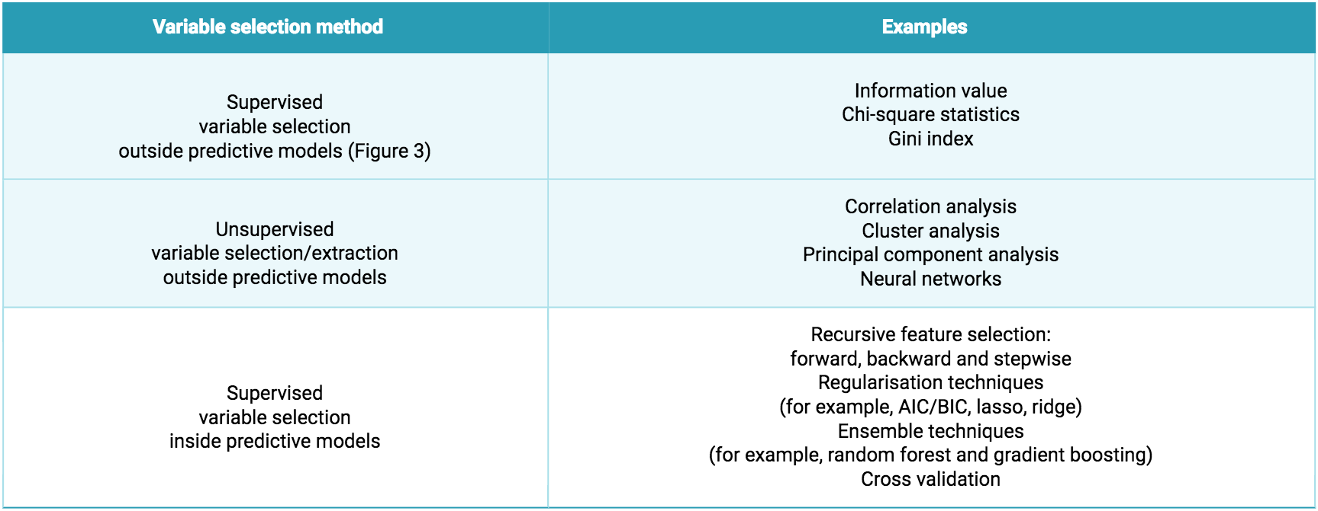
Notes:
Just like many things in life, eigenvectors, and eigenvalues come in pairs: every eigenvector has a corresponding eigenvalue. Simply put, an eigenvector is a direction, such as "vertical" or "45 degrees", while an eigenvalue is a number telling you how much variance there is in the data in that direction.

Slide 87
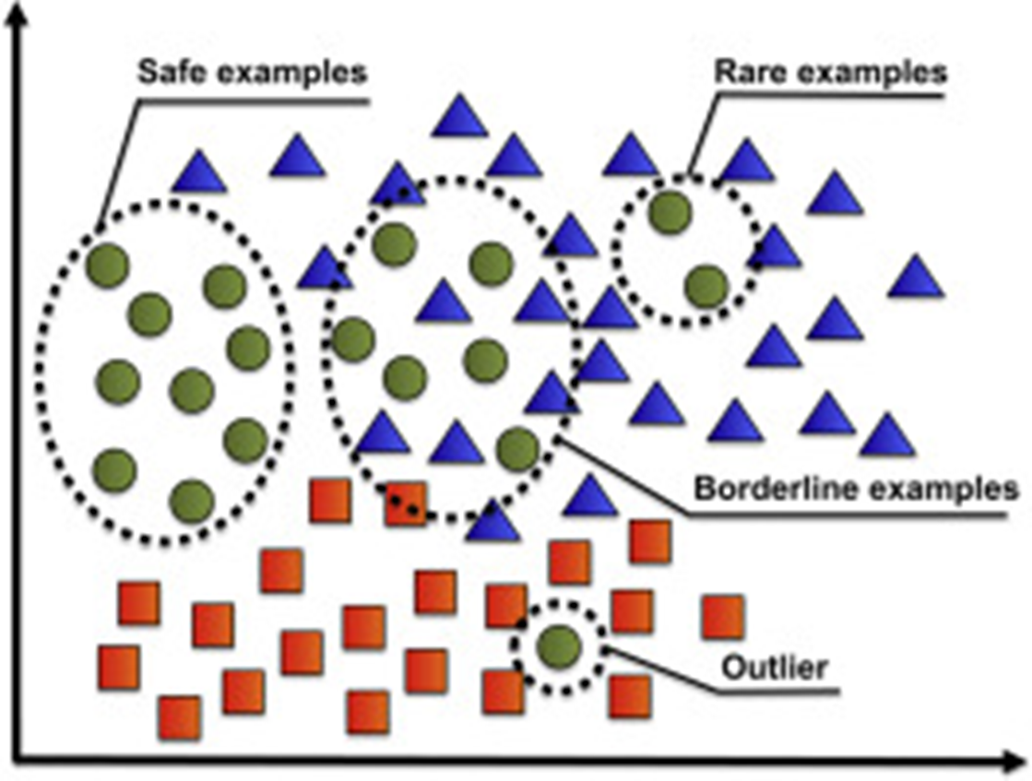

Slide 88
Oversampling for a Rare Event
You take a small proportion from non-event cases and a large proportion (or all the records) from the relatively few event cases.
Prior Probability : The prior probability is a probability of events before you have oversampled data. Posterior Probability : The posterior probability is a probability of events after you have oversampled data. It is a conditional distribution because it conditions on the observed data.
Posterior probability is normally calculated by updating the prior probability by using Bayes' theorem.

